Slide 1
Reading Scripture Prophetically
5. REVELATION

Slide 2
The Spectacles of Scripture
Clearly show us true knowledge of God
John Calvin 1509 – 64

Slide 3
Scripture a Mirror to see ourselves
Let His word be ever our mirror
James 1: 22–25

Slide 4
Revelation
Belongs to a world outside time with a quality all its own different from all the rest
Given directly by God

Slide 5
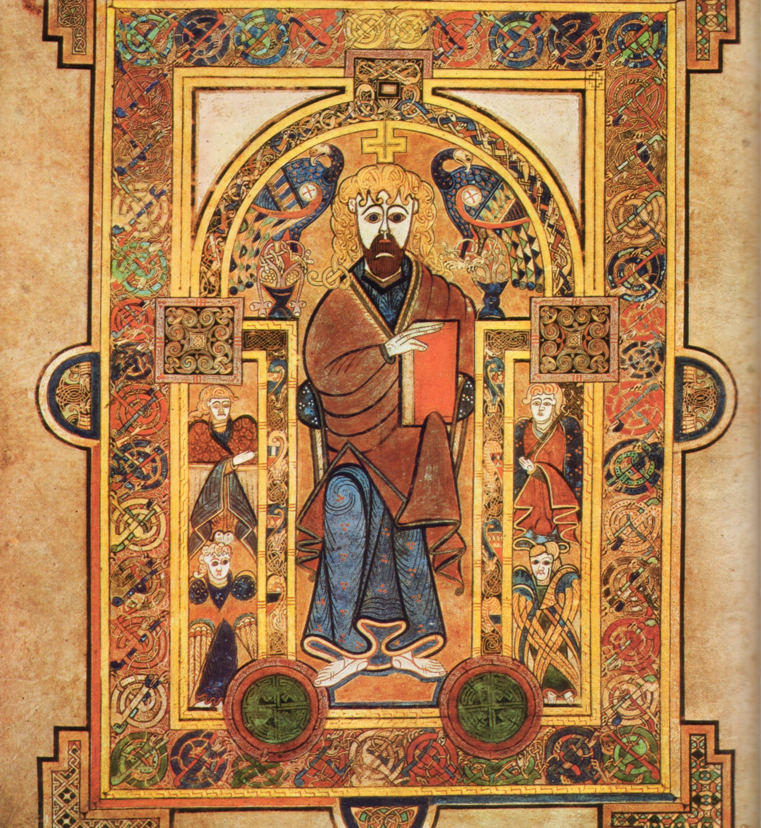
The Bible as Revelation
Who interprets?
Individual internally?
OR
Church externally?

Slide 6
The Spirit of Revelation
Guards the abiding revelation but with the newness of surprise

Slide 7
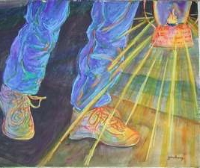
The spiritual or Prophetic sense in Scripture
A light to my path

Slide 8
A Figural Reading of Scripture
From the world of biblical figures to our world

Slide 9
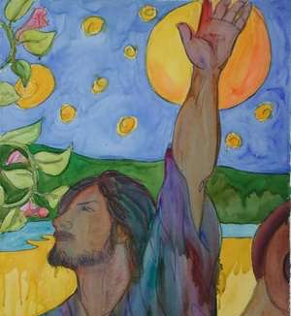
The Word
Living Hand shaping Bible events & our histories

Slide 10
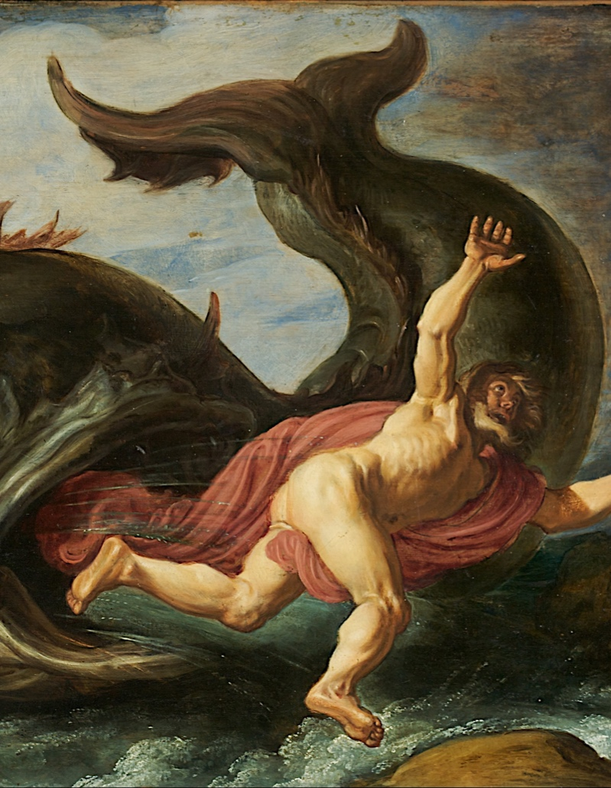
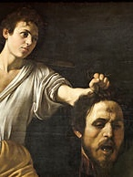
Heroes
Return of hero
Night or sea journey
Monster conquest

Slide 11
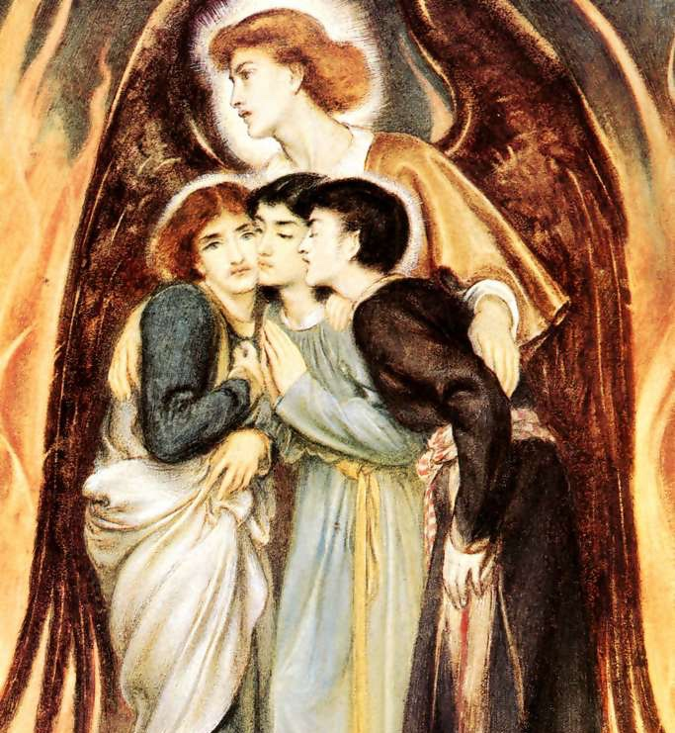
The Figure of the Son of Man
Daniel 3: 25

Slide 12
Bibliography
Letellier, Robert Ignatius, The Bible as revelatory word: 2 scripture as providential text the (late Old Testament narrative) [electronic resource] 2016 | Newcastle upon Tyne, UK : Cambridge Scholars Publishing. Accessed 11 September 2017.
Radner, Ephraim, Time and the Word: Figural Reading of the Christian Scriptures (Grand Rapids: William B. Eerdmans, 2016)
Rylaarsdam, J. Coert, Revelation in Jewish Wisdom Literature (Chicago: The University of Chicago Press 1946)
Scott, Ernest Finday, The New Testament Idea of Revelation (London: Ivor Nicholson & Watson Ltd, 1935)
Storer, Kevin, Reading Scripture to Hear God: Kevin Vanhoozer and Henri de Lubac on God's Use of Scripture in the Economy of Redemption (Edinburgh: James Clarke, 2015)

