Slide 1
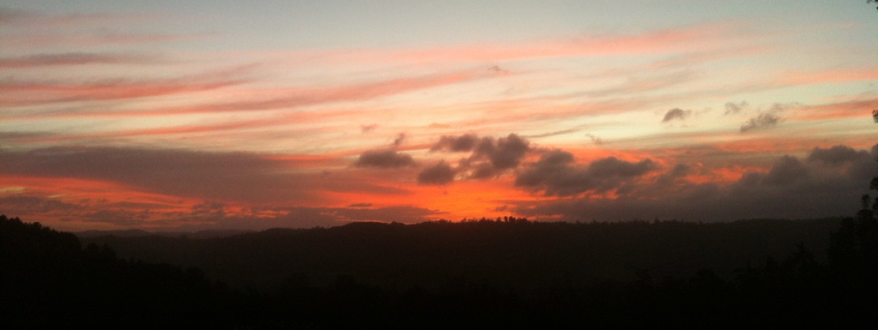
Reading Scripture Prophetically
3. Prophetic Symbols for Holy Spirit in Creation

Slide 2
Two Hands of God Word & Spirit
Ireneaus 130–200 ad

Slide 3
Two Hands Creation Recreation Preservation Re-formation

Slide 4
Holy Spirit in Creation

Slide 5
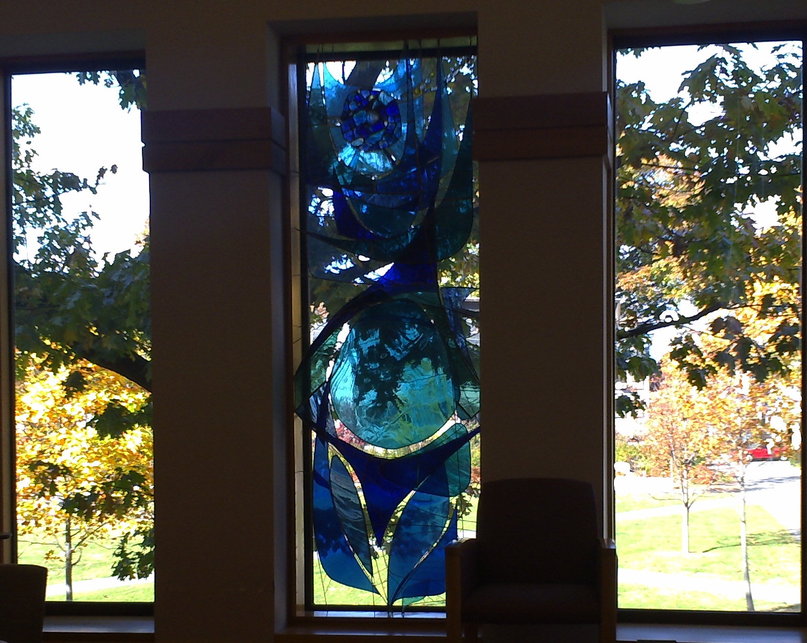
Holy Spirit in Creation
Genesis 1: 2
merahepheth
swept over, brooded, moved upon, was blowing

Slide 6
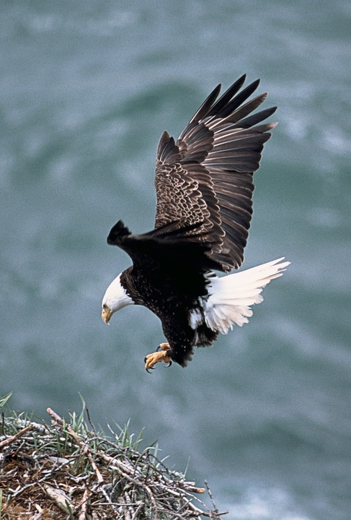
The Spirit of God
‘As an eagle incites its nestlings forth by hovering [merahepheth] over its brood’
Deuteronomy 32: 11

Slide 7
Symbols mysteriously demonstrate spiritual realities
‘When he created the world,
he gazed at it and adorned it with his images.
Streams of his symbols opened, flowed and poured forth
His symbols on his members.’
Hymns, Ephrem the Syrian (d.373)

Slide 8
Symbol of the Holy Spirit
‘Oil strengthens lamps to struggle with darkness until the sun comes with its breath and dispels it. The Spirit sustained the prophets so that falsehood was mitigated by truth Before the Sun Who pursues error by the twelve rays that He extends.’
Ephrem the Syrian, Hymns 5.2

Slide 9
Reading the Cloud as a Prophetic Symbol in Scripture
Exodus 24: 15–18
Exodus 33: 9–11
Exodus 40: 36–38
Luke 1: 35

Slide 10
Reading Prophetic Symbols
Genesis 24: 10–21
John 4: 1–14

Slide 11
Reading Symbols Prophetically
Jeremiah 2
Jeremiah 14
Jeremiah 38
John 2

Slide 12
References
Finan, Thomas & Twomey, Vincent eds. Scriptural Interpretation in the Fathers: Letter and Spirit (Dublin: Four Courts Press, 1995)
Hinze, Bradford E. & Dabney, D. Lyle, Advents of the Spirit : An Introduction to the Current Study of Pneumatology (Marquette University Press, 2001) ProQuest Ebook Central, Oxford, 2017-08-24
Robinson, J. St Irenaeus. The Demonstration of the Apostolic Preaching (London: SPCK, 1920)
Roberts and Donaldson, The Ante-Nicene Fathers, i, ‘Irenaeus against Heresies’
Van Groningen, Gerard, Messianic Revelation in the Old Testament (Grand Rapids: Baker Book House, 1990)

